Slide 1
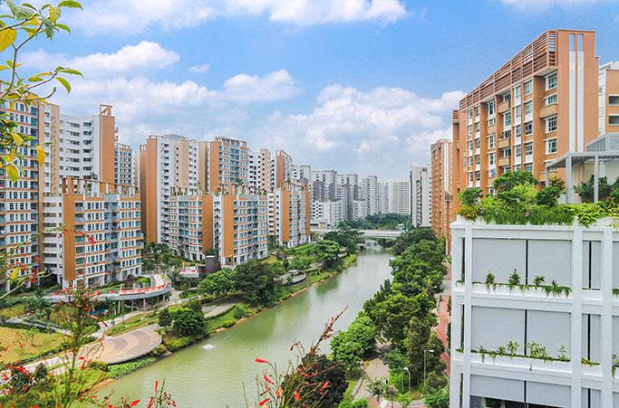
How To Market Your HDB Flat?
DSI 35:
Benedict - Kenneth - Shuying

Slide 2
Overview
BACKGROUND
METHODOLOGY
KEY FINDINGS
RECOMMENDATIONS

Slide 3

Problem statement
ResaleLeiLong is a HDB resale social network that offers a price estimator with prominent features for property agents.
Agents need to know what is a realistic price and what they can put on their property descriptions for the greatest impact on price.
L.L.

Slide 4
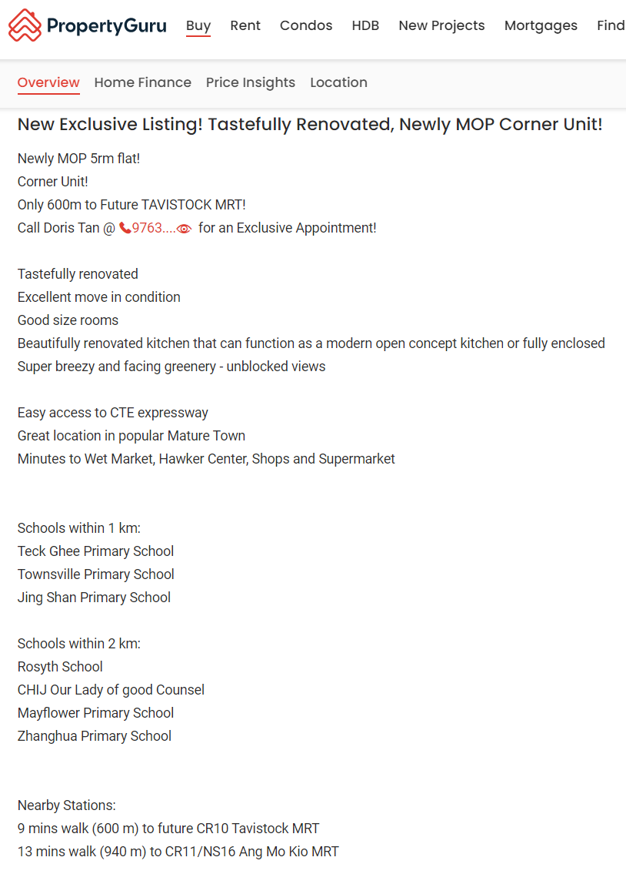
TMI!

Slide 5

Dear ResaleLeiLong,
I’ve got a 5 room in Ang Mo Kio that I want to push up the price.
What should I advertise on PropertyGuru?
Best Regards,
Simon
Million Dollar Roundtable

Slide 6
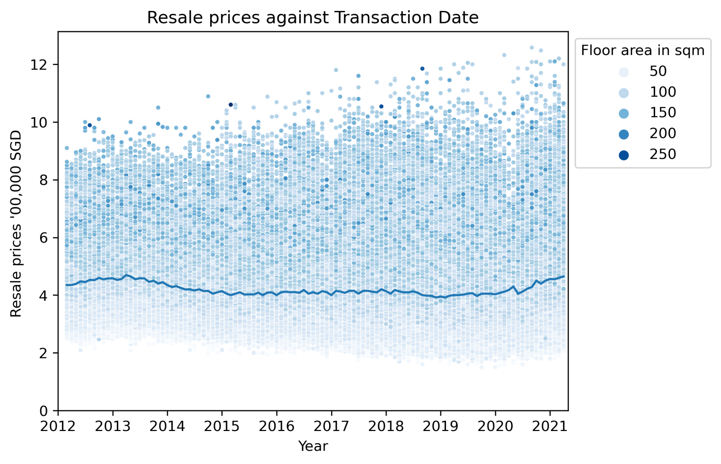
Historically robust
Median prices
Notes:
We can see that median prices have remain relatively stable. Our model will be consistent over the next few years.
However, the maximum transaction price has been increasing over the years.

Slide 7
Better predictive model through multiple iterations
Modular Approach:
Baseline
Median
Model A
Flat Characteristics (e,g. Age, Size...)
Model B
+ Amenities (e.g. MRT..)
Model C
+ Additional interactions
Error Size
(i.e. RMSE)
145,232
55,098
49,411
Improved
by
64%
Improved
by
13%
Notes:
SY -> Group by conditions (1) HDB Age/Lease Commencement Data (2) Flat type/Flat model/Full Flat Type (3) Floor level - lower/mid/upper (4) Seasonality - Year/Month (5) Amenities mall nearest dist, mall 500m/1km/2km etc.
Ben -> Check correlations with resale price -> had 2 initial models (floor_area_sqm, planning_area, block_type) and (full_flat_type, planning_area, block_type) -> Second model better about 65’000 vs 80’000 RMSE -> 3rd model consider interactions with flat type -> 3rd model 69’000 RMSE but can explain more.
Ken -> Check correlations with resale price -> based on correlation coefficients, select those with R-value > 0.5 -> groupby town/flat model and rank the top 10 prices -> top 5 towns coming from mature estates -> further look into features with 0.3 < R-value < 0.5 -> feature engineer some of them into new features(mature estate, remaining lease yrs of flat) -> passed into 1st model -> rinse and repeat for features with 0.1 < R-value < 0.3 when designing 2nd model

Slide 8
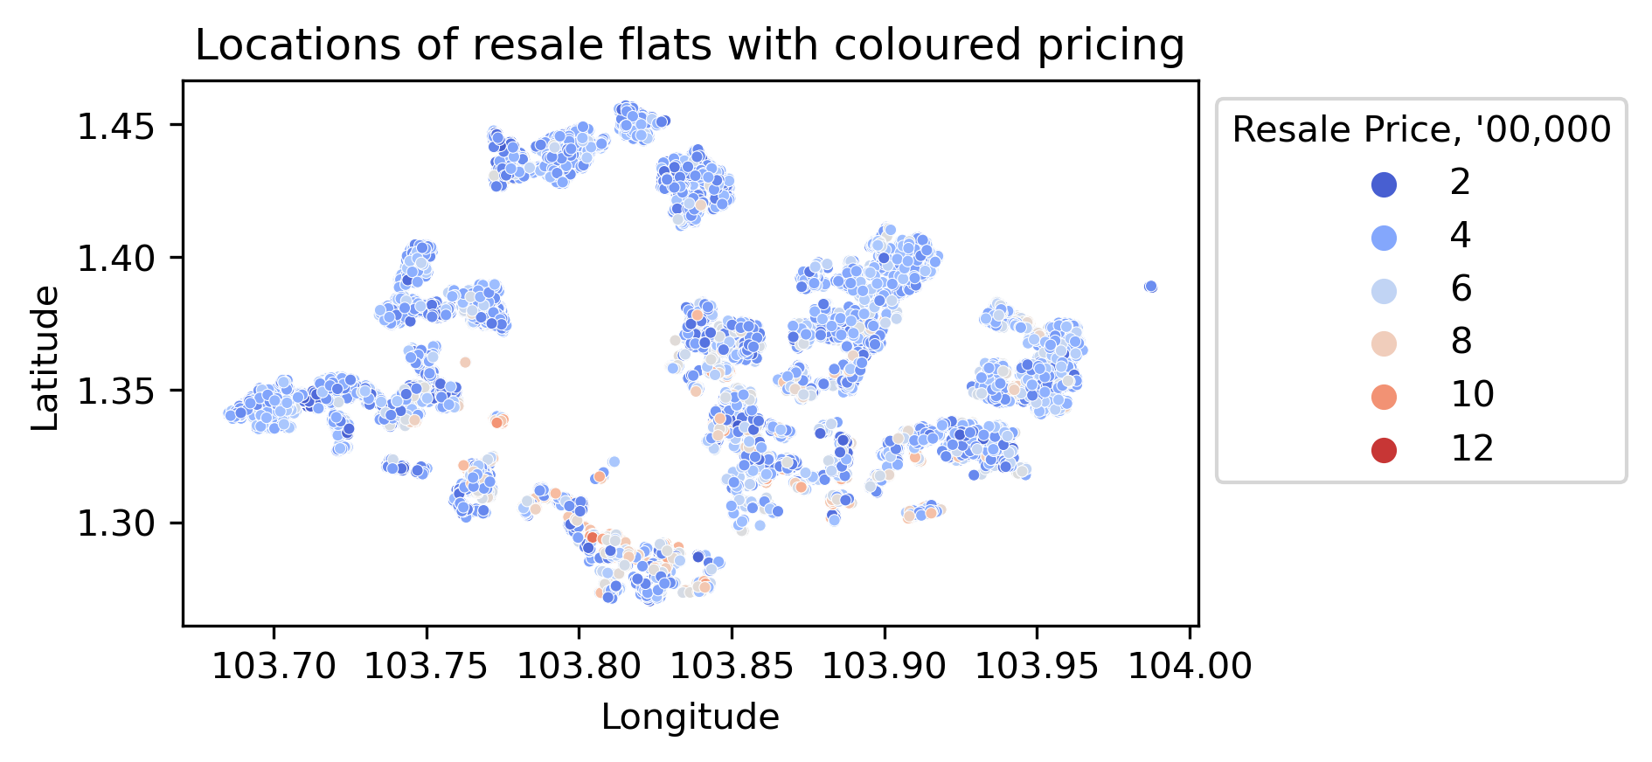
Distribution of transaction prices across Singapore
Yishun
Bishan
Bukit Timah
Changi
Marine Parade
Queenstown
Tanglin
Notes:
We can see that the transacted prices across the island are not equally distributed. Generally, central and southern regions have more expensive resale flats.

Slide 9
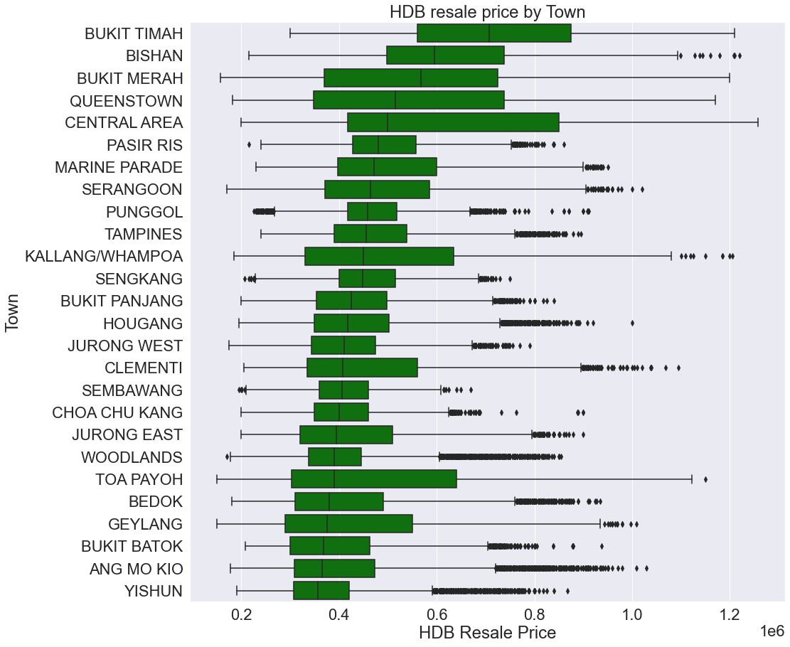
Bukit Timah, Bishan, Bukit Merah, Queenstown
Ang Mo Kio is a mature estate!
Notes:
Top 5 towns with the most expensive HDB resale prices are located at Mature Estates. AMK, Geylang, Bedok, Toa Payoh are mature estates with much lower median price, spectaculate due to consisting mainly of older flat types dragging down the overall price. 9/10 of top 10 towns with highest median prices come from mature estates(except Punggol)
11 towns listed as non mature: Bukit Batok, Bukit Panjang, Choa Chu Kang, Hougang, Jurong, Punggol, Sembawang, Sengkang, Tengah, Woodlands, Yishun.
15 towns are listed as mature: Ang Mo Kio, Bedok, Bishan, Bukit Merah, Bukit Timah, Central, Clementi, Geylang, Kallang/Whampoa, Marine Parade, Pasir Ris, Queenstown, Serangoon, Tampines, Toa Payoh.

Slide 10
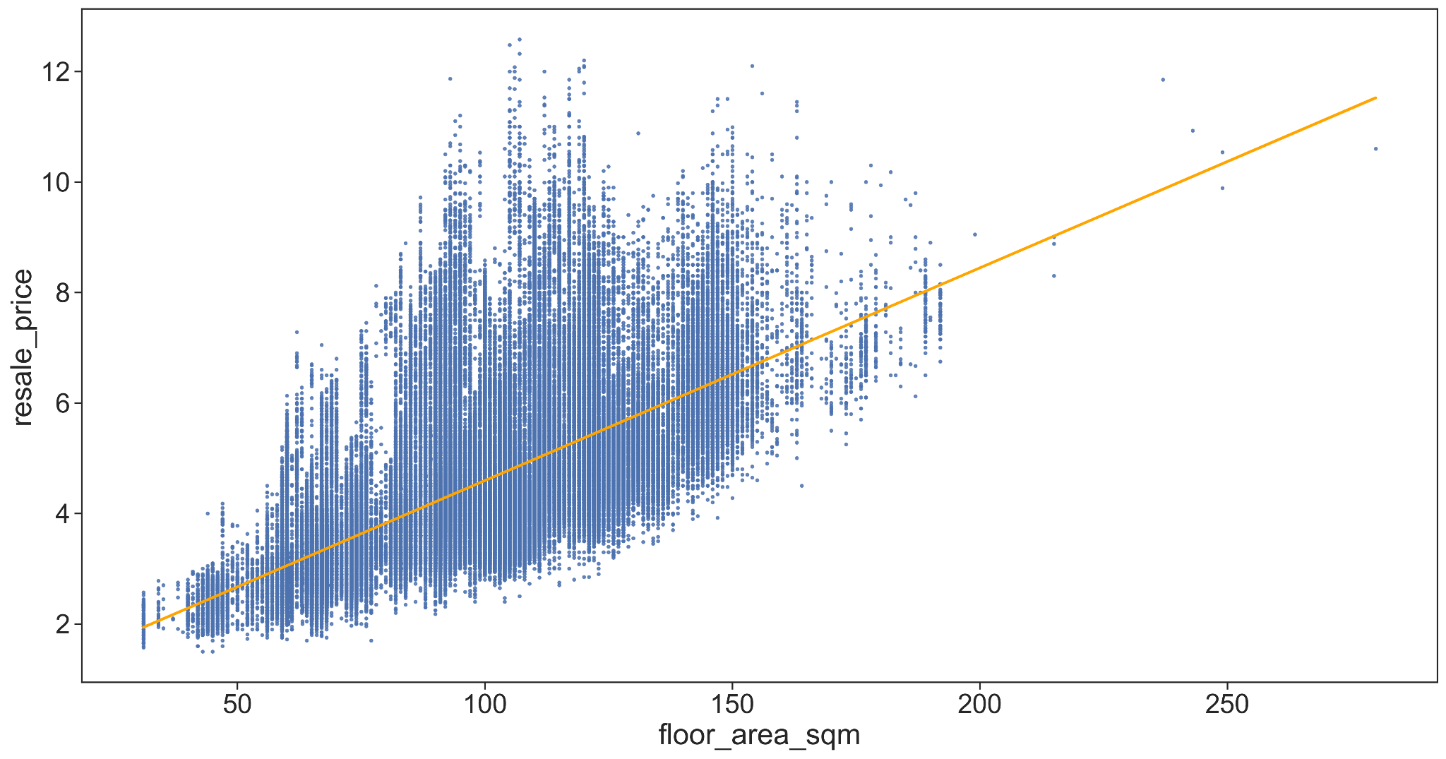
Floor area is not everything
Resale Prices
(’00, 000 SGD)
Floor Area (m²)
Notes:
We can see that the transacted prices across the island are higher with respect to greater floor area and higher max floor level. Different flat types are used in this plot which accounts for the variation in data points in this relationship between floor area and resale price. So basically Simon should not be putting all his hopes on floor area of his flat to secure a higher transaction :)

Slide 11
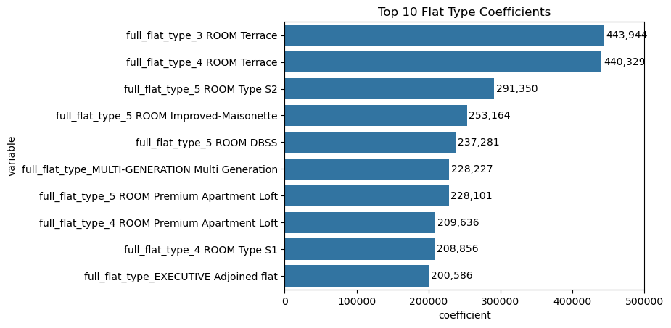
Terrace/Masionette/5 Rooms are worth more
Compared to regular flat types
Notes:
Hypothetically in comparison to regular flat types, Simon should recommend a higher price to be sold to clients for newer model of 5 room flats!

Slide 12
Hey Simon!
You should advertise the type of 5 Room!
It will surely bring up the price!
L.L.
Notes:
For Simon, he should defo advertise 5 room flats to jack up the prize and maintain his million dollar roundtable title!

Slide 13
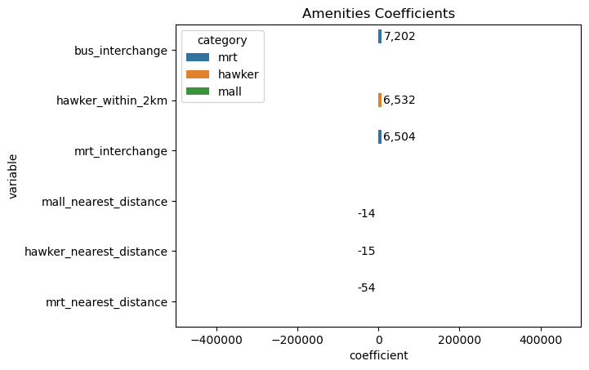
Amenities - Lesser significance
Don’t waste your space saying it’s close to MRT, malls, or hawker centres
L.L.
Notes:
We’re the same scale as the ones in the flat types, so by comparison, you can see that amenities have very small effect. Discard these factors when pitching his property to clients as he probably wont be able to convince them to purchase based on the data from the above chart showing little significance to the impact on his 5 room HDB price

Slide 14
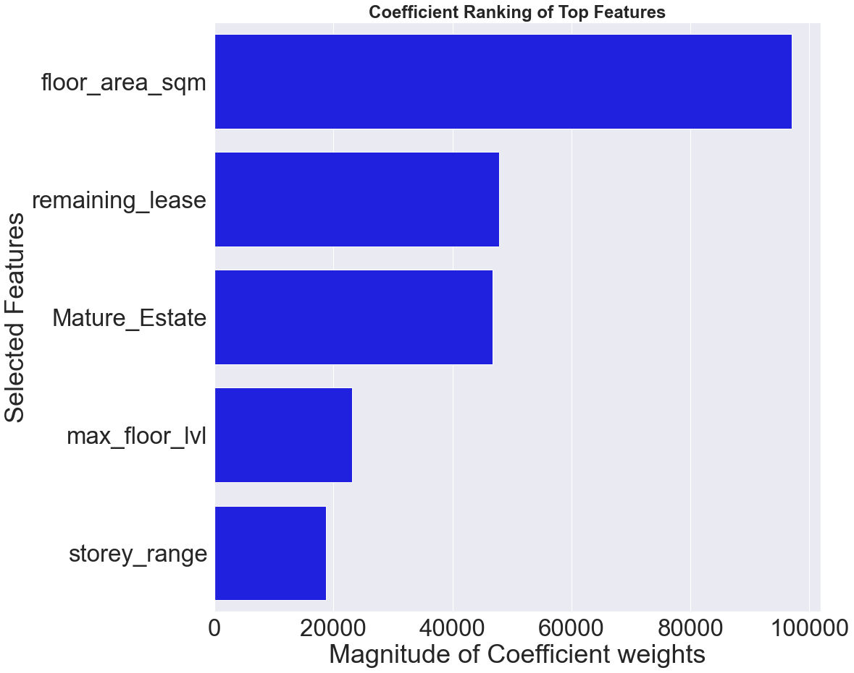
L.L.
Notes:
Remaining lease lifespan(in 99 years) of the flat, as well as if the flat is located in a mature estate should also be considered when recommending a price to be sold to Simon’s clients

Slide 15
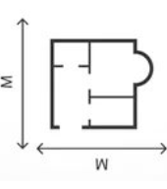
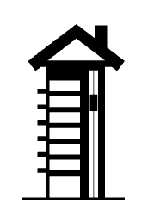


Inherent flat attributes, greatest impact on resale price
Flat Size
Every 100 sqft | +$30k
Flat Model (vs 5rm std AMK)
Premium Apartment Loft | +$355k
Type S2 | +$275k
DBSS | +$257k
Improved Maisonette | +$170k
Adjoint | +$56k
Improved | +$19k
Flat Type (vs 3 rm affordable)
Executive | +$78k
5-room | +$76k
4-room | +$52k
2-room | - $81k
Flat Location
Southwest/East | +$100k
North | -$100k

Slide 16




HDB block characteristics on resale price
HDB Block Height
Every 3 floors | +$18.5k
Accessibility
Mature Estate |  | +$47k
Remaining lease
Every additional yr remaining | +$47.4k
Hawker Centre Distance
For 4-room flats |  | +$19k
For 5-room flats |  | +$27k
For Executive flats |  | +$10k
Notes:
11 towns listed as non mature: Bukit Batok, Bukit Panjang, Choa Chu Kang, Hougang, Jurong, Punggol, Sembawang, Sengkang, Tengah, Woodlands, Yishun.
15 towns are listed as mature: Ang Mo Kio, Bedok, Bishan, Bukit Merah, Bukit Timah, Central, Clementi, Geylang, Kallang/Whampoa, Marine Parade, Pasir Ris, Queenstown, Serangoon, Tampines, Toa Payoh.

Slide 17
We are just scratching the surface…
How about some other features??
 | LR | Lasso | Ridge
Model A (Flat Characteristics Only) | 52,477 | 52,480 | 52,974
Model B (Including Amenities) | 45,898 | 46,307 | 45,900
Model C (Including Interactions) | 45,850 | 46,258 | 45,852
 | Kaggle 1 (Default - Model A) | Kaggle 2 (After tuning - Model B)
RMSE | 55,619 | 49, 411

Slide 18
Missing Features!

Slide 19
Oh wow! Thanks ResaleLeiLong!
I’m definitely confident about getting a good price for my client!

